Slide 1

Customer Shopping Behaviour Analysis
Transactional data insights across 3,900 purchases — spending patterns, segments & product preferences

Slide 2
Dataset at a Glance
3,900
18
37
Total Purchases
Features
Missing Values
Review Rating column only
Customer Data
Purchase & Behaviour
Age, Gender, Location, Subscription Status
Category, Amount, Discount, Frequency, Review Rating, Shipping Type

Slide 3
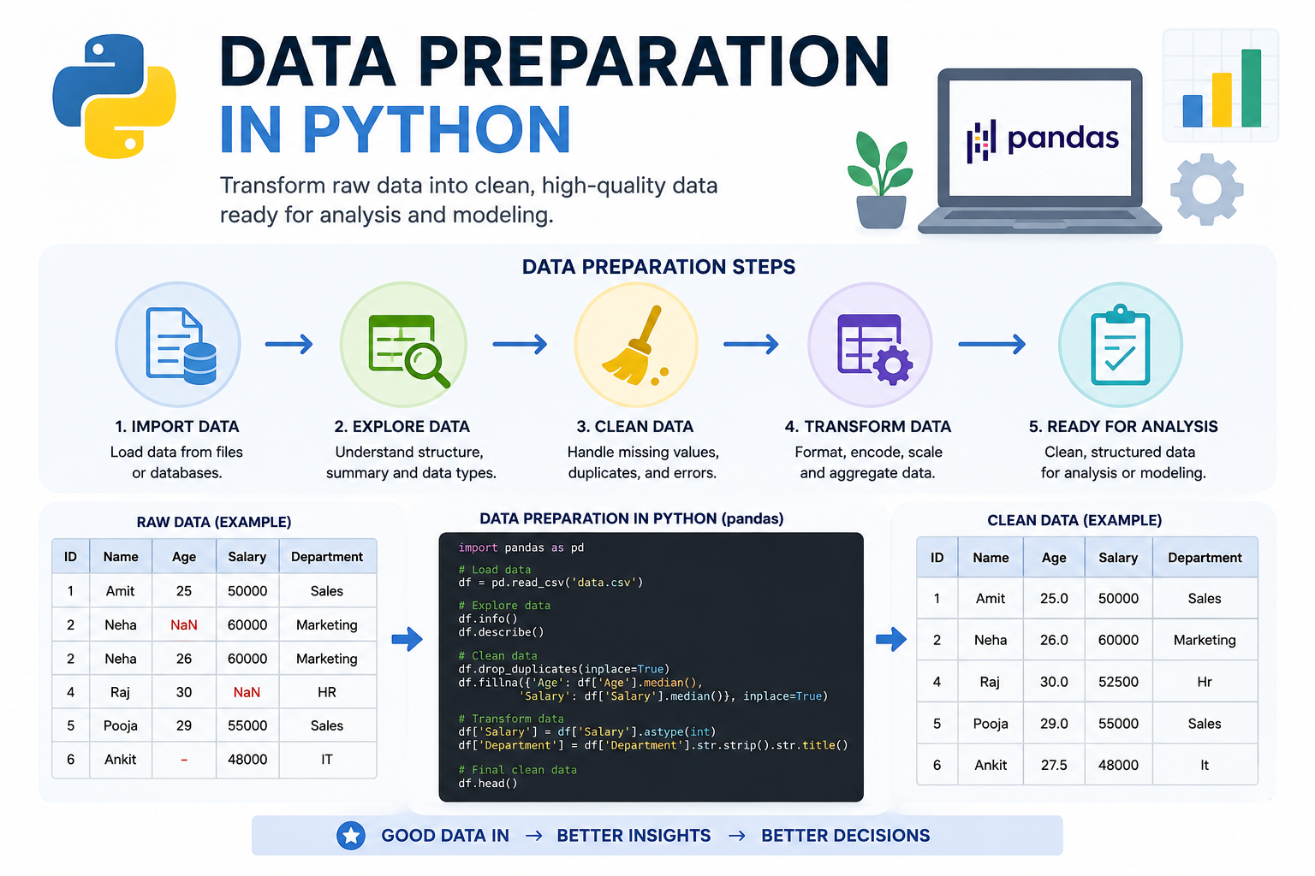
Data Preparation in Python
01
Load & Explore
pandas import, df.info(), .describe()
02
Clean & Standardize
Median imputation for Review Rating; snake_case columns
03
Feature Engineering
age_group bins, purchase_frequency_days
04
Load to PostgreSQL
Cleaned DataFrame → database for SQL analysis

Slide 4
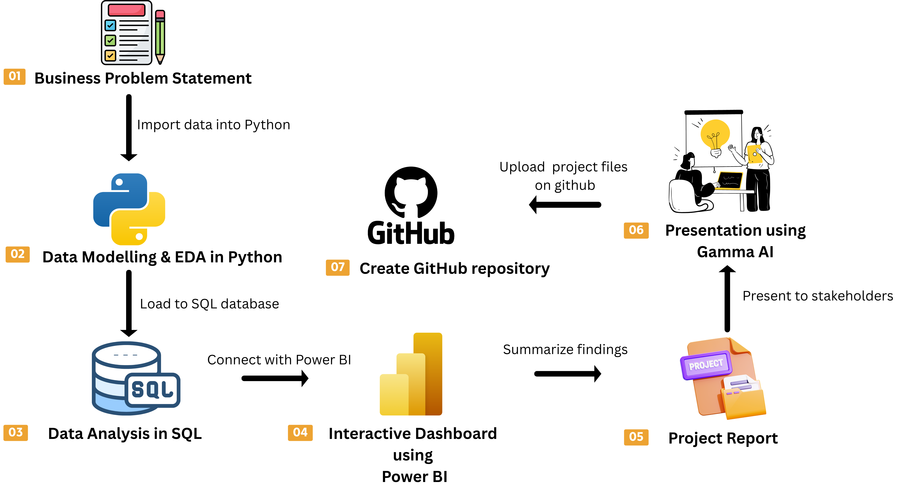
Project Overview

Slide 5
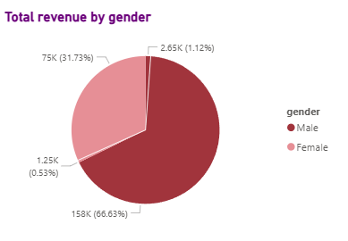
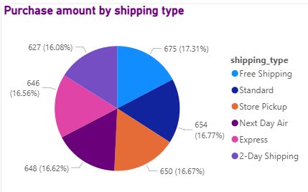
Revenue by Gender & Shipping Type
Revenue by Gender
Shipping Type Comparison
Compared total revenue generated by
male vs. female customers.
Average purchase amounts: Standard vs. Express shipping.

Slide 6
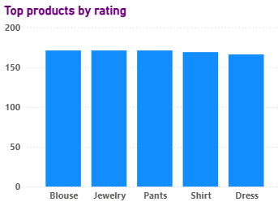
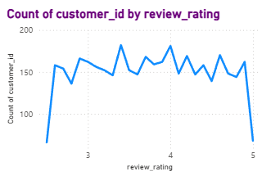
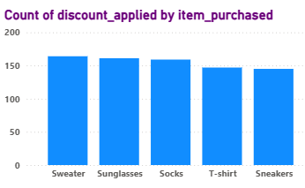
Top Products & Shipping Insights
Top 5 Products by Rating
Review by Customers
Discount-Dependent Products
Highest average review ratings per product
Highest review ratings as per customers
5 products with highest % of discounted purchases

Slide 7
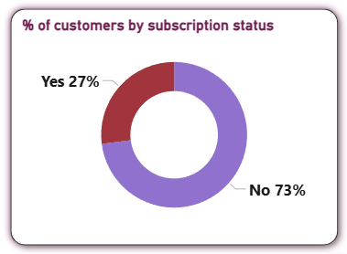
Subscribers vs. Non-Subscribers
Average Spend & Revenue
Compared average spend and total revenue across subscription status to assess subscriber value.

Slide 8
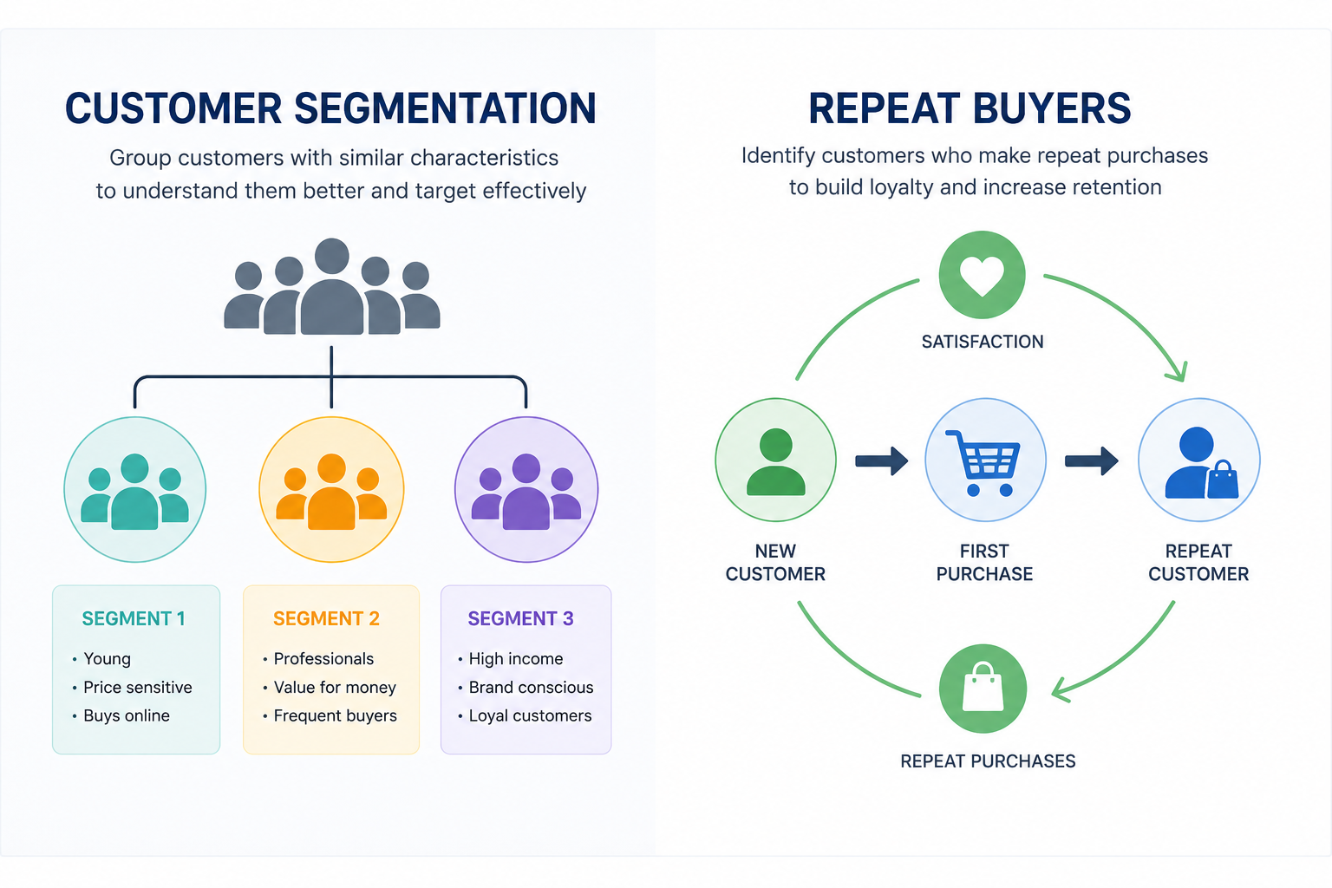
Customer Segmentation & Repeat Buyers
Three Customer Segments
New
First-time buyers
Returning
Repeat purchasers
Repeat Buyers
Loyal
Customers with >5 purchases are more likely to subscribe
High-frequency buyers

Slide 9
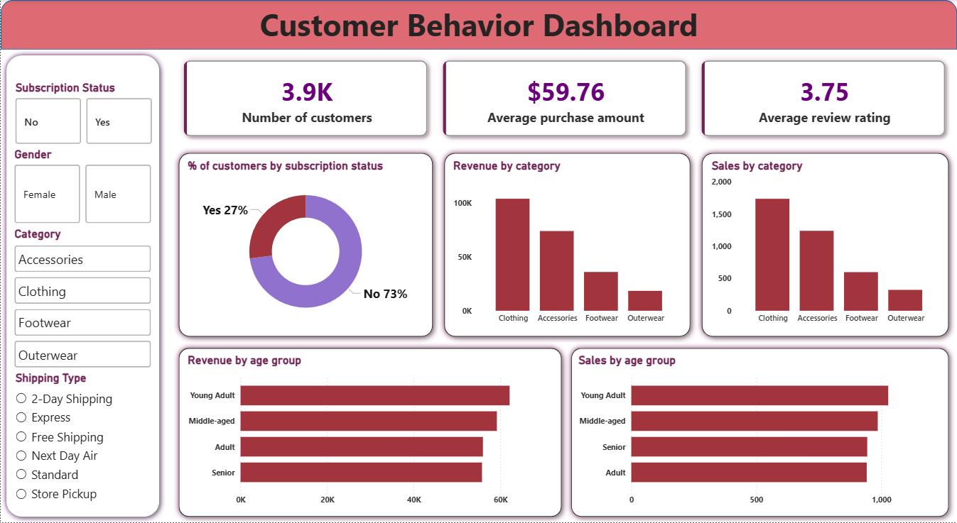
Power BI Dashboard
Interactive dashboard built to present all insights visually — enabling stakeholders to explore data dynamically.

Slide 10
Dashboard & Recommendations
Boost Subscriptions
Loyalty Programs
Review Discounts
Promote exclusive subscriber benefits
Reward repeat buyers → Loyal segment
Balance sales lift with margin control
Product Positioning
Targeted Marketing
Highlight top-rated & best-sellers
Focus on high-revenue age groups & express-shipping users

